Slide 1
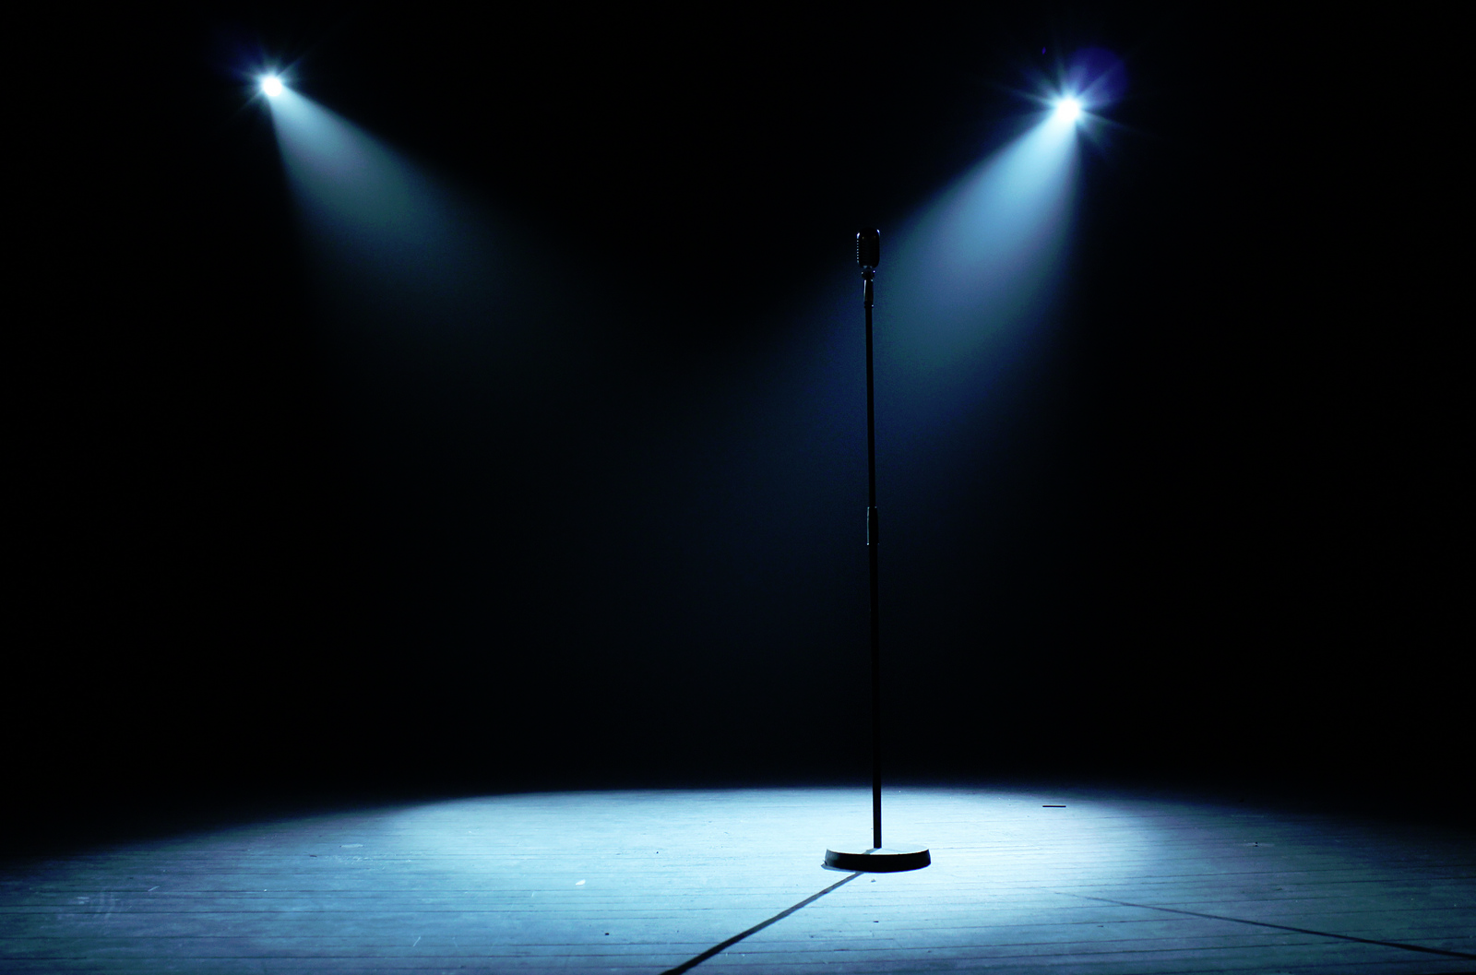
Different Mediums,
Same Messages:
Character Assassination Practices during
the Ukrainian Crisis
Sergei Samoilenko,
Elina Erzikova,
Alexander Laskin,
& Sergey Davydov

Slide 2
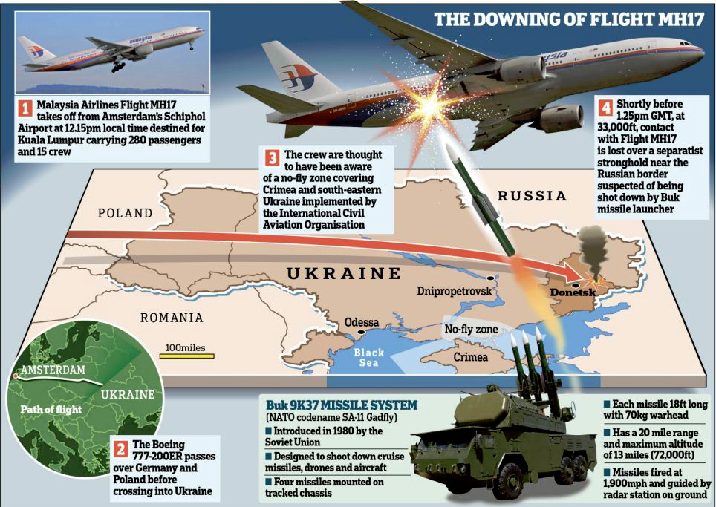
Character Assassination Practices
during the Ukrainian Crisis

Slide 3
Character Assassination Practices
during the Ukrainian Crisis
Character assassination (CA) is a deliberate and sustained effort
to damage the reputation
or credibility of an individual
or organization.

Slide 4
Character Assassination Practices
during the Ukrainian Crisis
Method: Content analysis of broadcast transcripts
Broadcasting networks included in the study:
Three Russian (Pervyi Kanal, Rossiya-1, NTV) &
three US (ABC News, CBS News, NBC News).

Slide 5
Character Assassination Practices
during the Ukrainian Crisis
Russia: Pervyi Kanal, Rossiya-1, NTV
The US: ABC News, CBS News, NBC News
Russia The US
The length of transcripts
(words) ranged from 59-3,555 333-11,340
The mean 717 1,355

Slide 6
Character Assassination Practices
during the Ukrainian Crisis
Table 1. Number of news stories broadcasted from July 17-August 16, 2014 by three Russian TV channels.
_______________________________________________________________________________________
Channel # of stories % Plane crash as main topic (#) %
_______________________________________________________________________________________
Pervyi Kanal 41 26.8 28 24.3
Rossiya-1 67 43.8 54 47.0
NTV 45 29.4 33 28.7
Total 153 100 115 75.2
___________________________________________________________________

Slide 7
Character Assassination Practices
during the Ukrainian Crisis
Table 2. Focus of news stories broadcasted from July 17-August 16, 2014 by three Russian TV channels.
____________________________________________________________________________________________________
Focus Television Channels
Pervyi Kanal Rossiya-1 NTV Total
____________________________________________________________________________________________________
Political 30 26.5 52 46.0 31 11.5 113 42.2
Military 21 25.0 40 47.6 23 27.4 84 31.2
Social 21 36.8 20 35.1 16 28.1 57 21.2
Economic 2 4 0 6 2.2
Historic 0 3 1 4 1.5
Cultural 1 1 1 3 1.1
Other 0 1 1 2 0.7
Total 75 27.9 121 45.0 73 27.1 269
___________________________________________________________________________________________________

Slide 8
Character Assassination Practices
during the Ukrainian Crisis
Table 3. Types of attack detected in news stories broadcasted from July 17-August 16, 2014 by three Russian TV channels.
____________________________________________________________________________________________
Type Television Channels
Pervyi Kanal Rossiya-1 NTV Total
____________________________________________________________________________________________
Silencing 32 35.2 37 40.7 22 24.2 91 36.1
Anonymous lies 16 30.2 23 43.4 14 26.4 53 21.0
Misquoting 10 20.0 27 54.0 13 26.0 50 19.8
Demonization 10 24.4 23 56.1 8 19.5 41 16.3
Name-calling 3 6 2 11 4.4
Acts of
vandalism 1 1 0 2 0.8
Mental illness 0 1 0 1 0.4
Total 72 28.6 121 48.0 59 23.4 252
____________________________________________________________________________________________

Slide 9
Character Assassination Practices
during the Ukrainian Crisis
Table 4. Subjects of attack in news stories broadcasted from July 17-August 16, 2014 by three Russian TV channels.
____________________________________________________________________________________________
Subject Television Channels
Pervyi Kanal Rossiya-1 NTV Total
_____________________________________________________________________________________________
Ukrainian Government 25 28.7 41 47.1 21 24.1 87 33.3
Ukraine as Country 13 26.5 29 59.2 7 14.3 49 18.8
US government 9 11 6 26 10.0
Ukrainian President 7 12 4 23
Ukrainian official 5 11 4 20 7.7
US president 2 13 2 17 6.5
Protesters 2 2 1 5 1.9
Ukrainians
as Nation 2 0 0 2 0.8
Other 9 11 12 32 12.3
Total 74 28.4 130 49.8 57 21.8 261
______________________________________________________________________________________________

Slide 10
Character Assassination Practices
during the Ukrainian Crisis
Table 5. Focus of news stories broadcasted from July 17-August 16, 2014 by three US TV networks.
_____________________________________________________________________________________________
Focus Television Channels
ABC News (n=11) CBS News (n=18) NBC News (n=5) Total
_____________________________________________________________________________________________
Military 9 7 3 19
Political 5 4 2 11
Social 1 0 0 1
Economic 0 1 0 1
Other 8 4 1 13
Total 23 16 6 45
____________________________________________________________________________________

Slide 11
Character Assassination Practices
during the Ukrainian Crisis
Table 6. Types of attack detected in news stories broadcasted from July 17-August 16, 2014 by three US TV networks.
________________________________________________________________________________________________
Type Television Channels
ABC News CBS News NBC News Total
________________________________________________________________________________________________
Demonization 10 6 2 18
Name-calling 3 4 0 7
Silencing 0 1 0 1
Total 13 11 2 26
______________________________________________________________________________________

Slide 12
Character Assassination Practices
during the Ukrainian Crisis
Table 7. Subjects of attack(s) in news stories broadcasted from July 17-August 16, 2014 by three US TV networks.
__________________________________________________________________________________________
Subject Television Channels
ABC News CBS News NBC News Total
__________________________________________________________________________________________
Protesters 9 8 2 19
Russia as Country 4 4 2 10
Russian President 2 0 1 3
Russian Government 0 3 0 3
Russians as Nation 0 1 0 1
Total 15 16 5 36
__________________________________________________________________________________________

Slide 13
Character Assassination Practices
during the Ukrainian Crisis
Highlights
The Russian channels produced more news stories than US networks
(153 vs. 35).
The opposing sides used various types of character assassination.
A greater degree of diversification for subject and type of attack in news by three Russian TV channels.

Slide 14
Character Assassination Practices
during the Ukrainian Crisis
Highlights
Russia
Main types of attack: silencing
Main focus: political
Main subject of attack: Ukrainian
government

Slide 15
Character Assassination Practices
during the Ukrainian Crisis
Highlights
Russia the US
Main types of attack: silencing demonization
Main focus: political military
Main subject of attack: Ukrainian
government protesters

Slide 16
Character Assassination Practices
during the Ukrainian Crisis
Highlights
Russia the US
Main types of attack: silencing demonization
Main focus: political military
Main subject of attack: Ukrainian
government protesters
None of the sides attacked its own government

